Slide 1
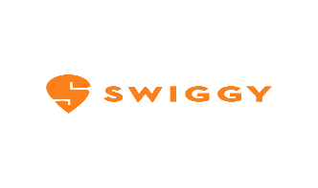
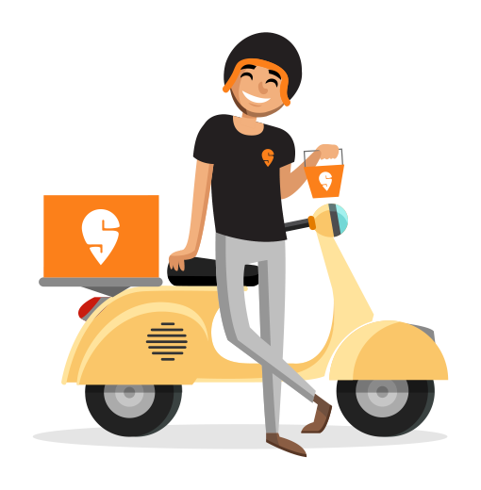
Sales & Customer Performance Analysis
Tools Used: SQL Server | Power BI
Prepared By: Kavita Bijarniya

Slide 2

Objective of This Analysis
This presentation evaluates Swiggy’s sales and customer performance using data analysis tools. The goal is to provide insights on revenue trends, city and restaurant rankings, customer behaviors, and satisfaction levels across the analysis period. Key findings will support data-driven recommendations for business growth and improved customer engagement.

Slide 3
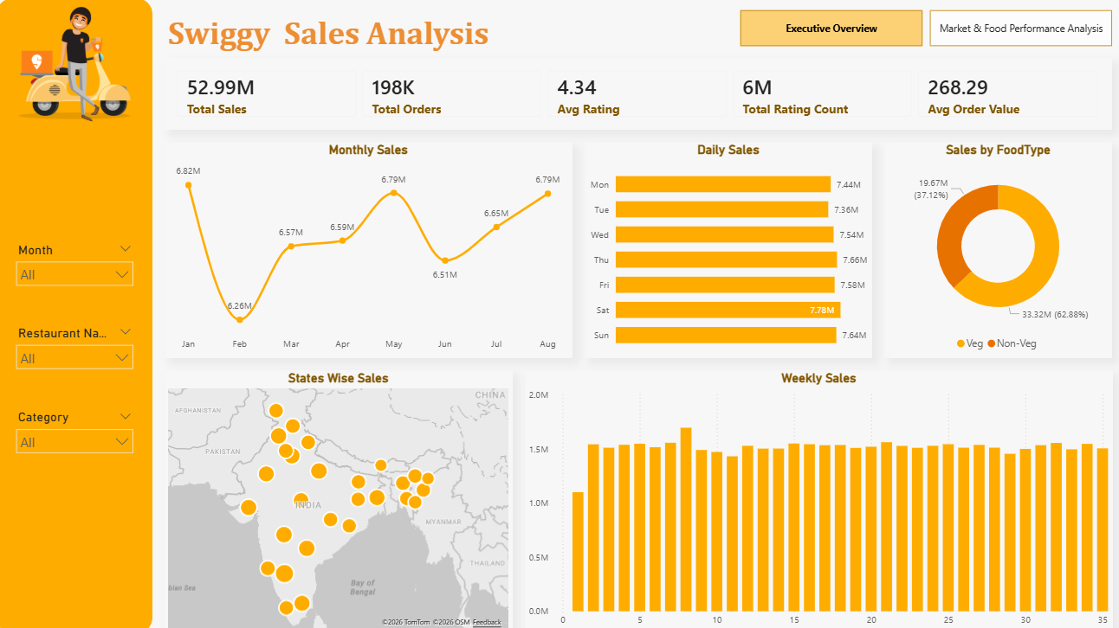
Executive Overview

Slide 4
Key Business Insight
Total Revenue reached ₹52.99M across 198K orders
Average Order Value stands at ₹268
Overall customer satisfaction is strong with 4.34 average rating
Weekend sales (especially Saturday) show peak performance
Bengaluru leads in revenue contribution
Consistent monthly revenue with minor fluctuations
Strong revenue momentum in peak months (May & August)
Stable average order value across the period
Total rating count of 6M, indicating strong platform engagement
Insight: Business performance is stable with clear seasonal peaks.

Slide 5
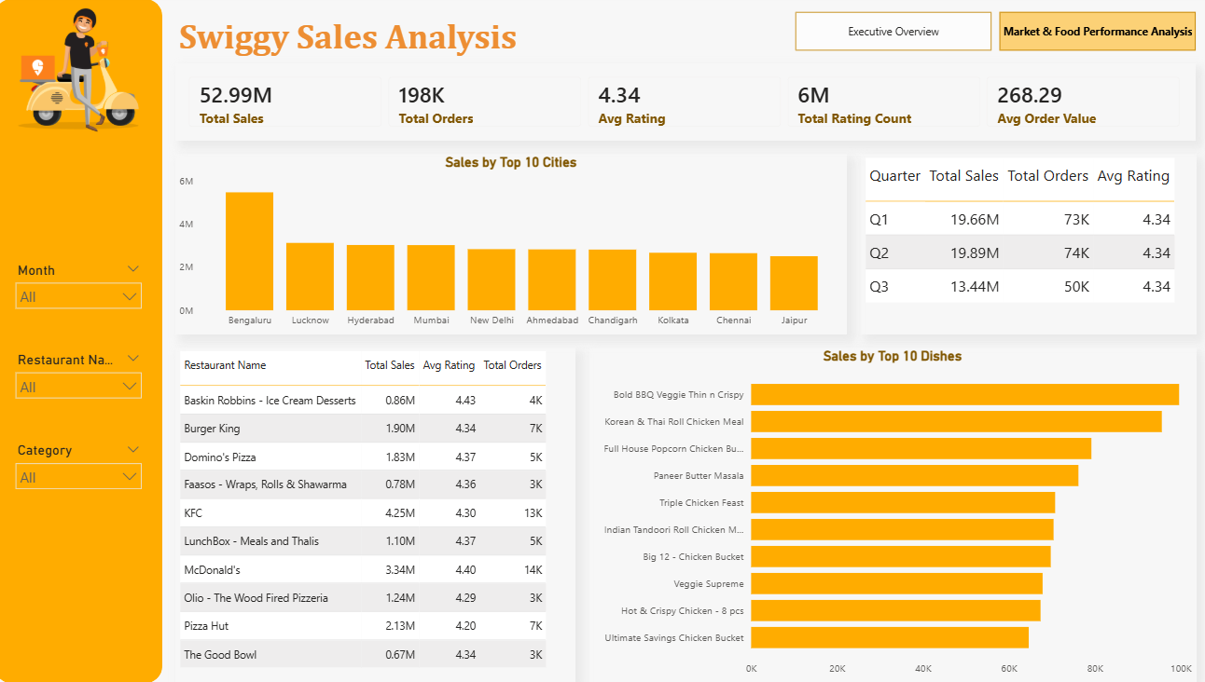
Market & Food Analysis

Slide 6
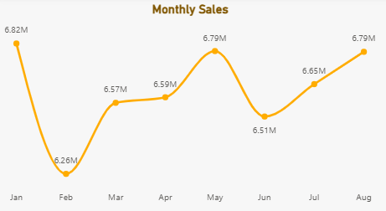
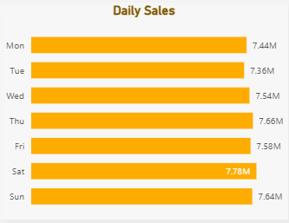
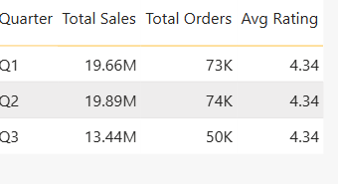
Sales Trend Analysis
Saturday records the highest daily sales
February shows a temporary dip in revenue
Quarterly performance:
Q2 performed strongest in revenue & orders
Q3 showed slight slowdown
Insight: Sales are weekend-driven, suggesting opportunity for targeted weekday promotions.

Slide 7
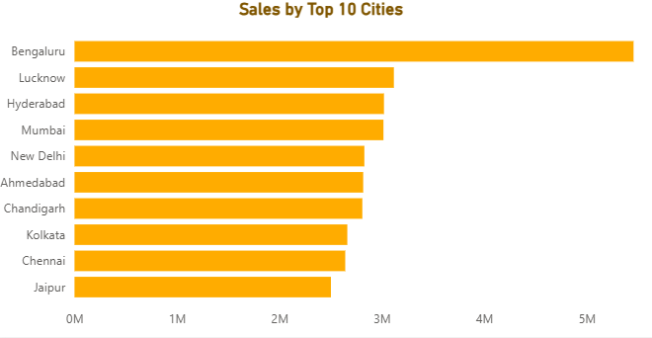
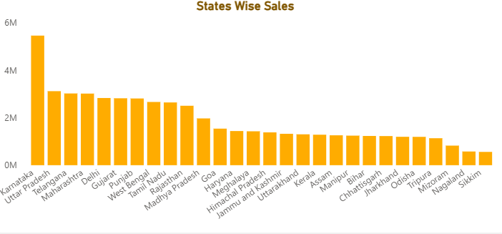
Geographic Performance
Bengaluru is the top-performing city
Revenue contribution is concentrated among top 10 cities
Karnataka contribute significantly higher share of revenue
Insight: Revenue concentration suggests opportunity for expansion in mid-tier cities.

Slide 8
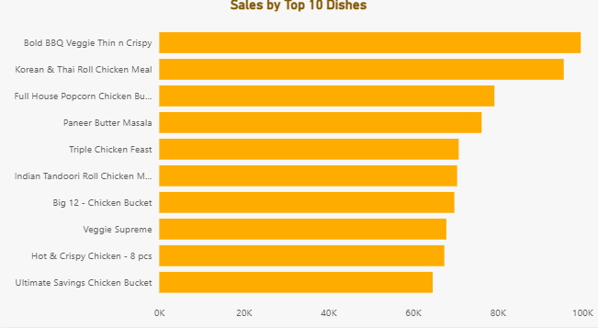
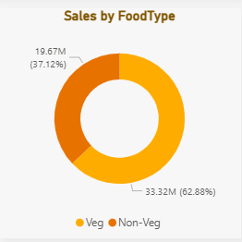
Cuisine & Dish Performance
Veg category contributes higher revenue share
Top dishes drive a significant portion of total sales
Popular items maintain strong ratings
Insight: Menu optimization and promotion of top dishes can further increase revenue.

Slide 9
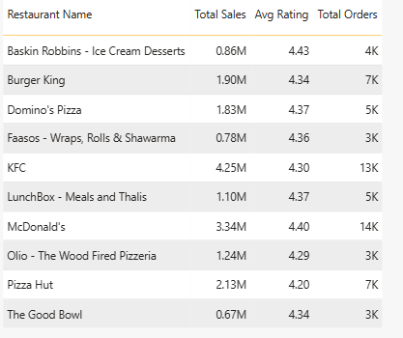
Restaurant Performance
Leading brands generate strong order volume and revenue
High-performing restaurants maintain ratings above 4.3
Some mid-tier restaurants show good ratings but lower order volume
Insight: High-rated but lower-order restaurants may benefit from better visibility or promotions.

Slide 10
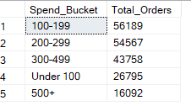
Customer Spending Behavior
Majority orders fall within ₹200–₹299 range
Premium segment (₹500+) contributes smaller volume but higher value
Lower price buckets show high order frequency
Insight: Customers are price-sensitive but premium upselling opportunities exist.

Slide 11

Satisfaction and Ratings
Customer satisfaction remains strong with an average rating of 4.34. Most ratings range between 4 and 5 stars, signaling high service quality. Very few low ratings indicate minimal dissatisfaction risk. This performance underscores successful service delivery and a positive customer experience on the Swiggy platform.

Slide 12
Targeted Recommendations
Focus marketing efforts on weekends to capitalize on peak sales days. Promote high-rated yet low-order restaurants to boost visibility and revenue. Expand presence in promising mid-tier cities to diversify revenue sources. Introduce premium combos for higher spending customers and offer weekday discounts to encourage balanced demand throughout the week.

Slide 13
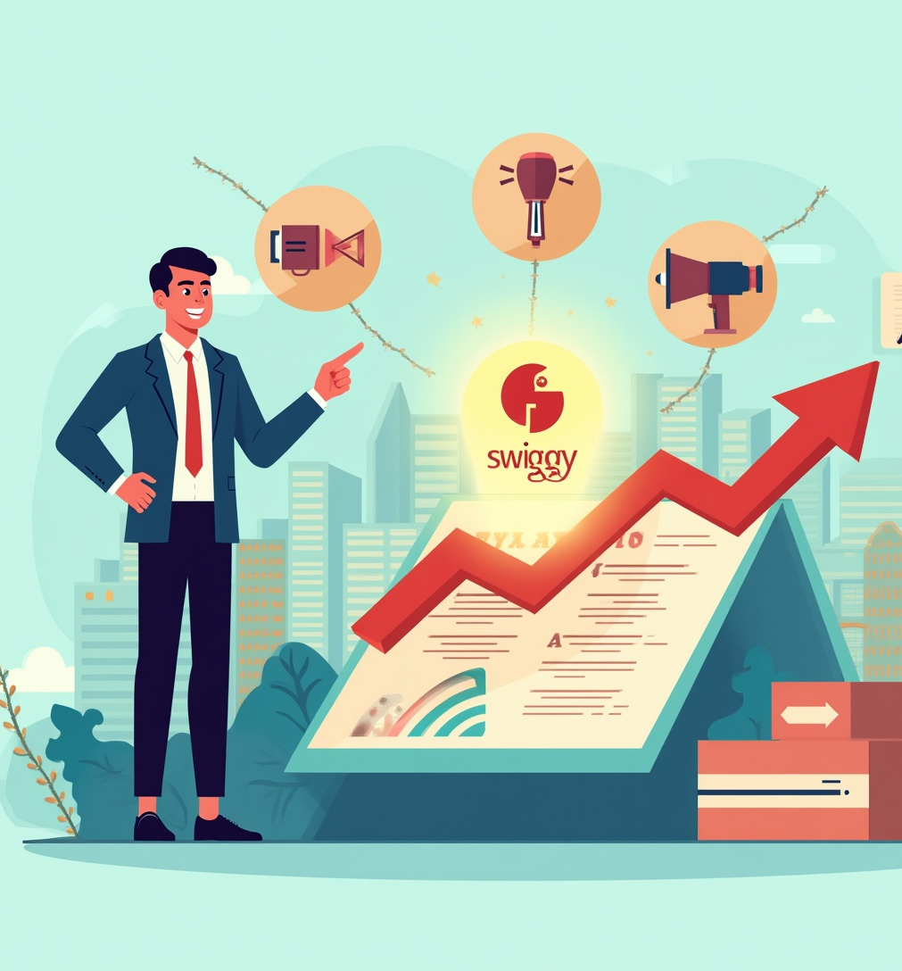
Conclusions
Swiggy’s business shows stable, growth-oriented performance supported by strong customer satisfaction. Insights reveal opportunities for geographic expansion, menu optimization, and targeted marketing strategies. Data-driven actions will further enhance revenue growth, customer retention, and long-term business sustainability.

Slide 14
Thanks!
Do you have any questions?

